Slide 1


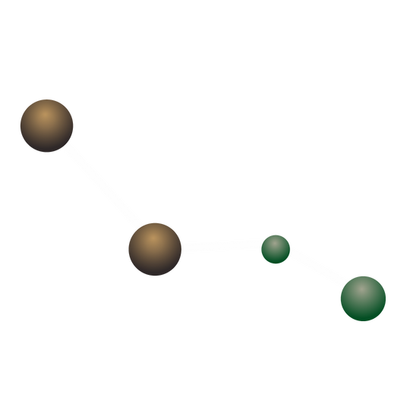
Drug-Target Interaction prediction via Binding Affinity based on Deep Learning
N. Elattar*, O. Elkhamisy, S. Abdelkhabir, S. Ezz-Eldeen, S. Ayman, A. Gabr, A. Eldakroury, A. Ali

Slide 2

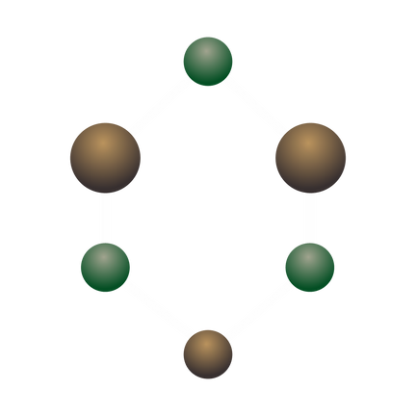
Table of contents
I
II
III
Introduction
Methodology
Results
Introduction and Objectives
Data, Methods and Model Architecture.
Results, Limitations and Future Work

Slide 3


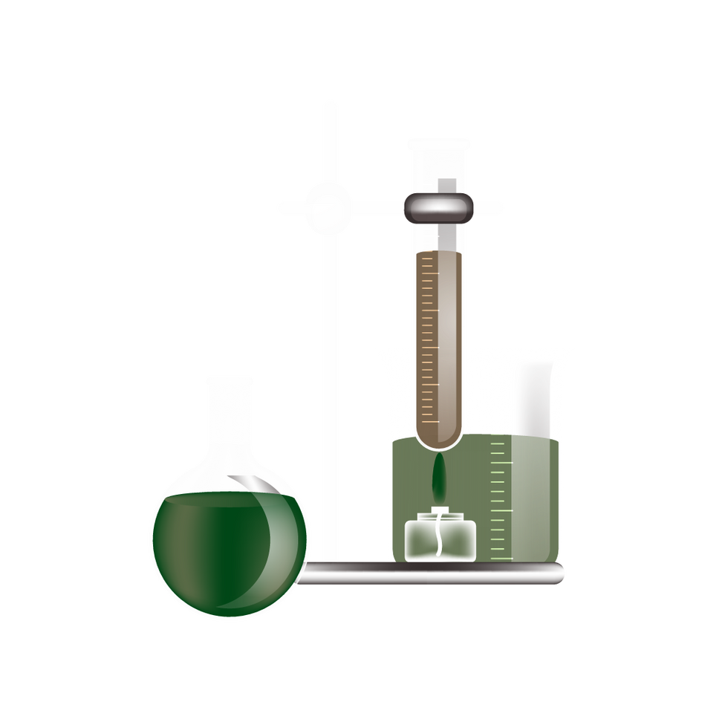

I
Introduction

Slide 4
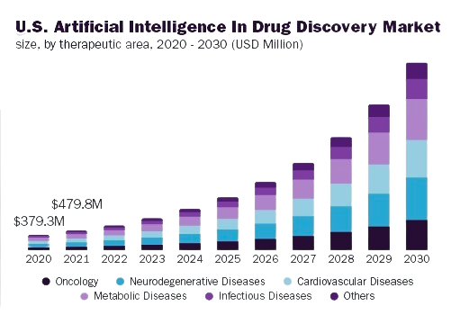
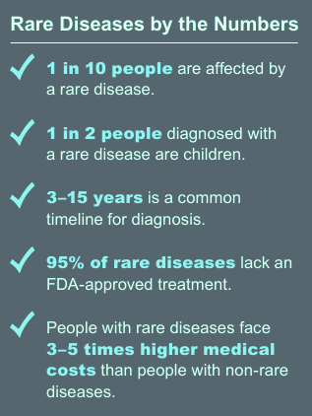
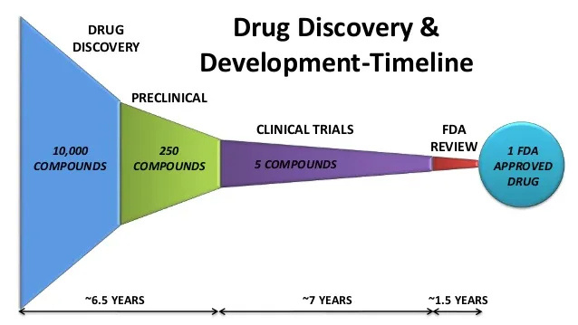
MOTIVATION
GRAND VIEW RESEARCH
DRUG DISCOVERY AND DEVELOPMENT TIMELINE - MEDIUM REPORT
NIH - REPORT JANUARY 2023

Slide 5

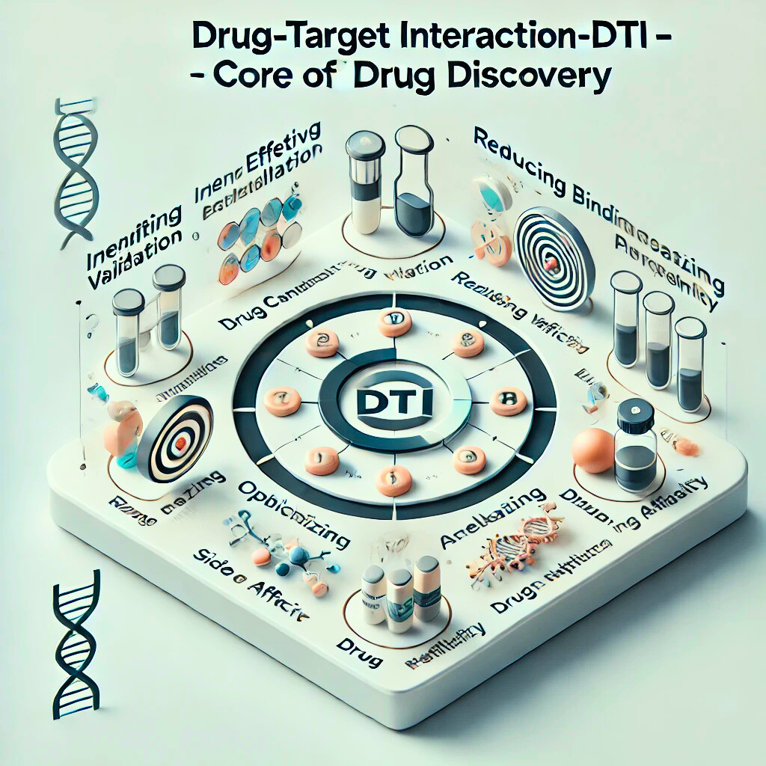
INTRODUCTION
Overview of DTI: Drug-Target Interaction (DTI) refers to how drugs interact with specific biological targets, such as proteins or enzymes, essential to understanding drug mechanisms.
Role in Drug Discovery: DTI analysis enables researchers to identify new drugs that can accurately target disease pathways, paving the way for more effective treatments.

Slide 6
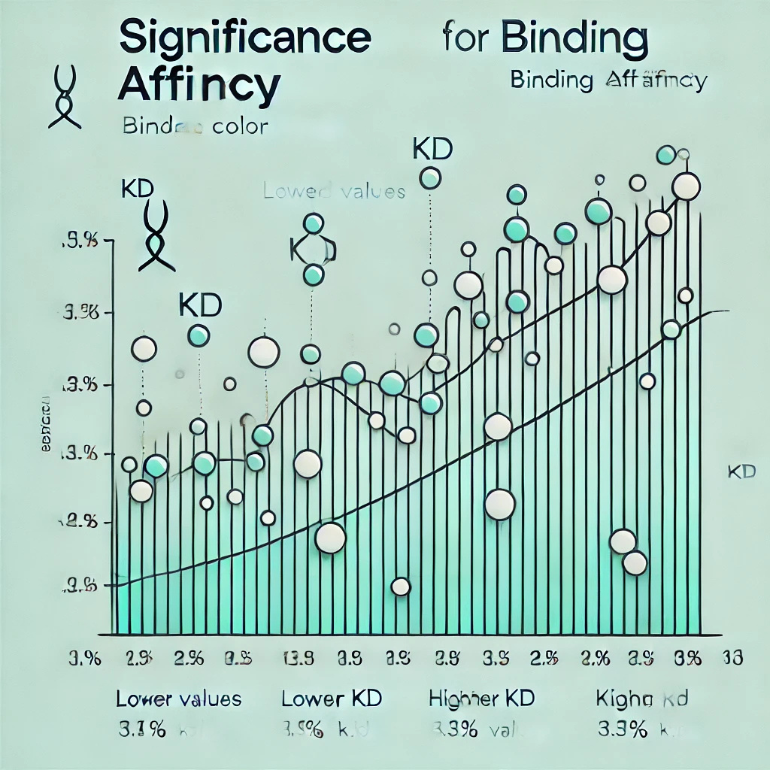
INTRODUCTION
Binding Affinity: measures the strength of a drug's interaction with its target, typically using the Equilibrium Dissociation Constant (KD). A lower KD value indicates a stronger binding, essential for evaluating therapeutic potential.
Significance: High Binding Affinity is key for effective, targeted therapies, contributing to fewer side effects and supporting personalized medicine.

Slide 7
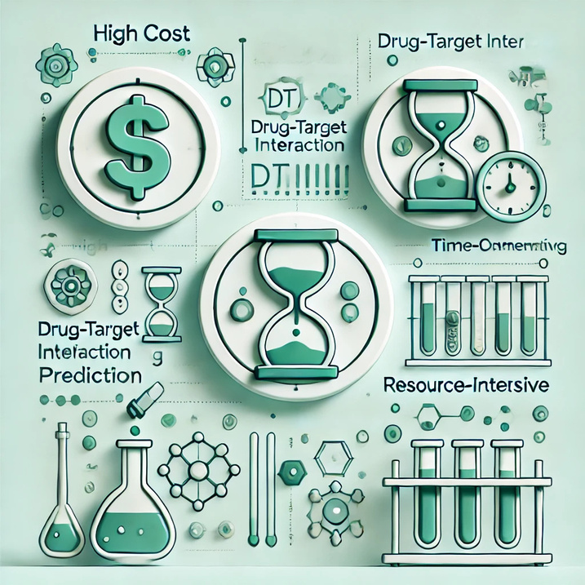
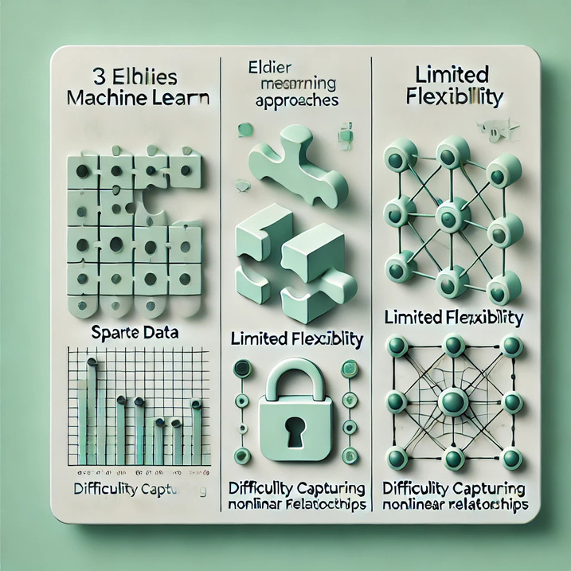
PROBLEM STATEMENT
Traditional DTI Approaches:
High-Cost: Laboratory experiments for measuring drug-target interactions require significant financial investment.
Time-Intensive: Lab-based methods are slow, often taking days to weeks for results.
Resource-Intensive: Dependence on specialized lab equipment makes scaling to large datasets challenging.
2. Earlier Machine Learning Approaches:
Sparse Data: Insufficient or missing data impacts model accuracy and reliability.
Limited Flexibility: Earlier ML models lack adaptability, making it difficult to generalize across different drug-target pairs or apply to new, unseen data.
Difficulty Capturing Nonlinear Relationships: Traditional ML models may struggle to capture nonlinear relationships between drug properties and target interactions, limiting their predictive power.

Slide 8
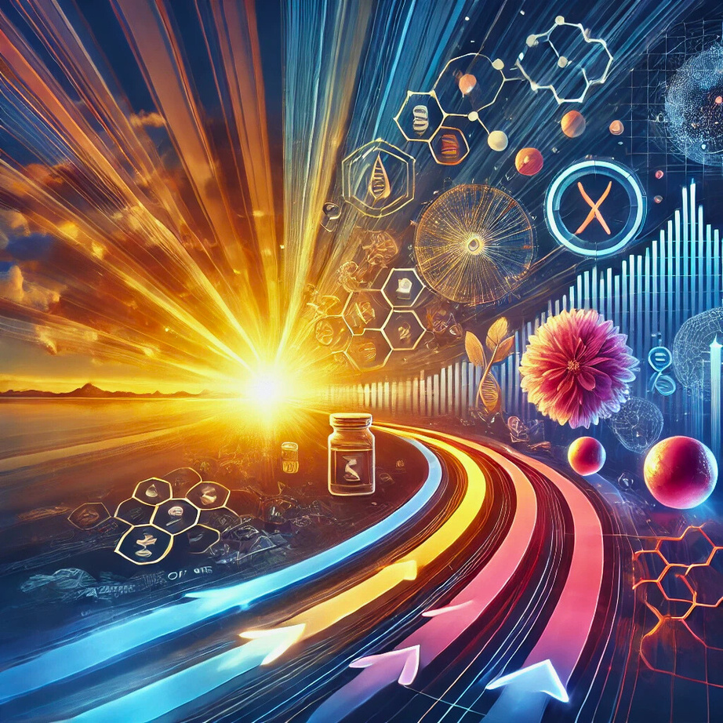
OBJECTIVE
Goal: Accurately predict Drug-Target Binding Affinity using computational models to enable faster, efficient drug discovery with a user-friendly interface.
Key Innovations:
Minimize Side Effects: Focus on drugs with high binding affinity to reduce off-target effects.
Accelerate Drug Repurposing: Identify existing drugs for new diseases by predicting binding affinity with novel targets.
Scalability: Extract insights from large datasets for accurate, scalable predictions.
API Access: Provide easy access to predictions for healthcare professionals via a user-friendly API.

Slide 9
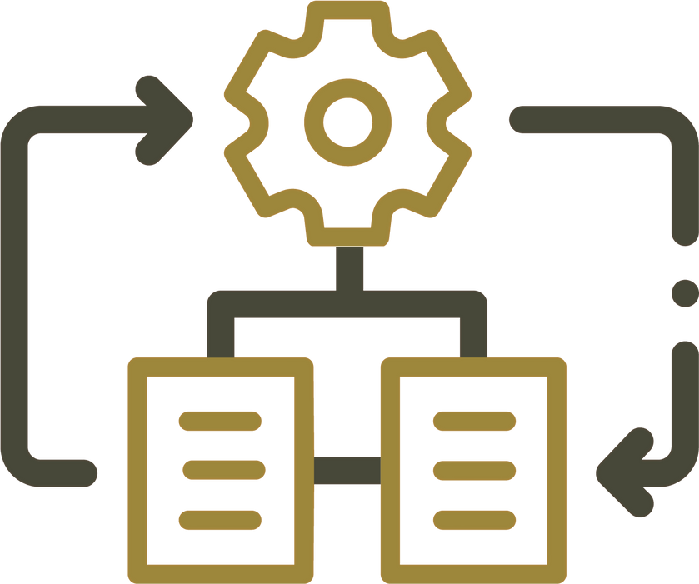
II
Methodology

Slide 10

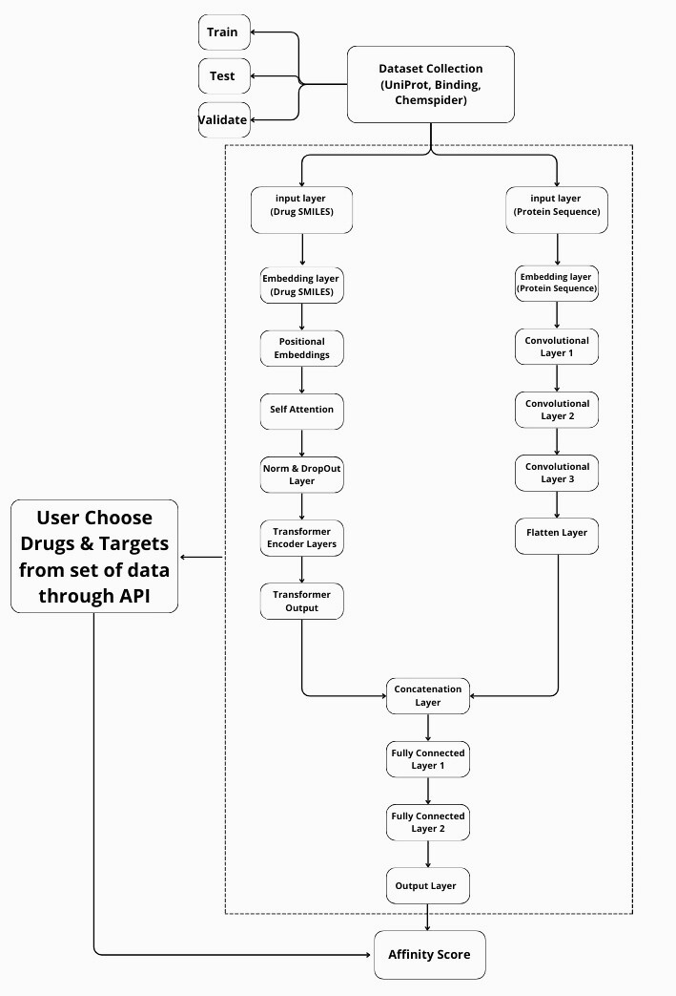
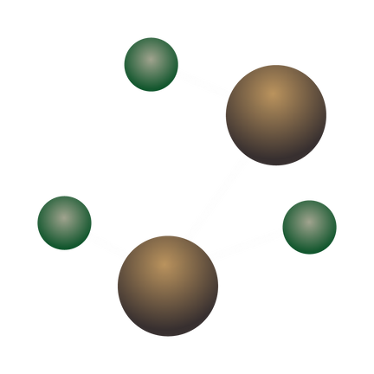
OVERVIEW OF THE METHODOLOGY
The primary objective is to predict drug-target binding affinities using deep learning, a crucial step that accelerates the drug discovery process by helping identify potential drug candidates efficiently.

Slide 11
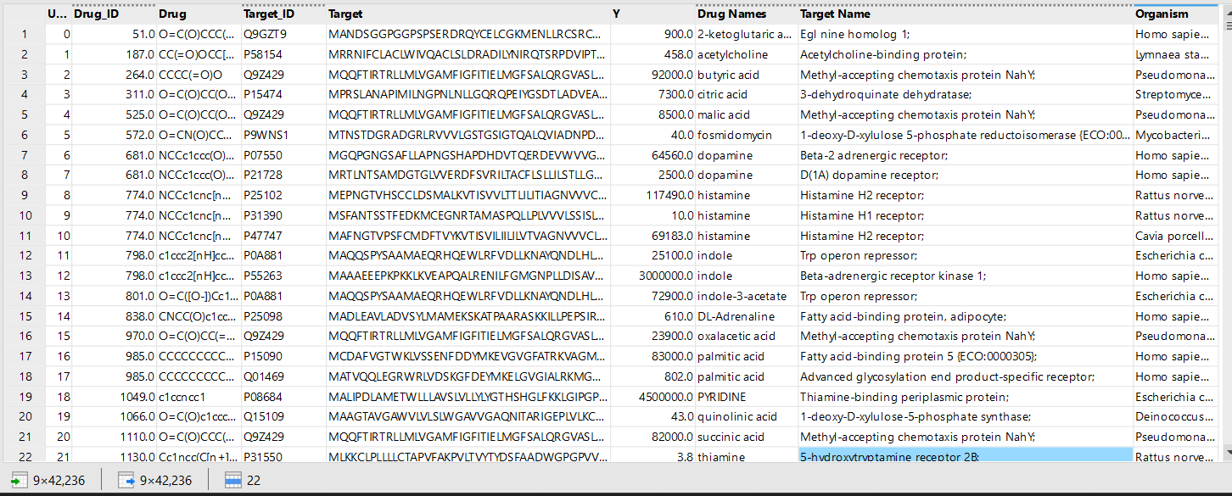
DATA DESCRIPTION
Key Points:
Total Rows: 42,236 records, focusing on drug-target interactions.
Columns: 9 columns, with key data including drug names, target names, and organism types.
Distinct Counts and Data Types:
Drug: 9,864 distinct drugs (Categorical-Nominal).
Target: 1,090 distinct targets (Categorical-Nominal).
Organism: 58 distinct organisms (Categorical-Nominal).
Y (Binding Affinity Score): 2,749 distinct affinity values (Numerical-Continuous).

Slide 12
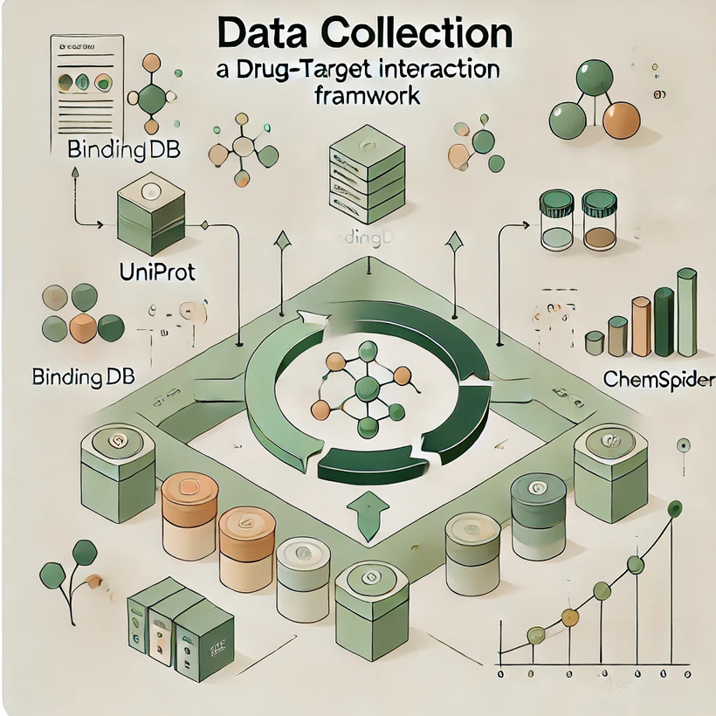
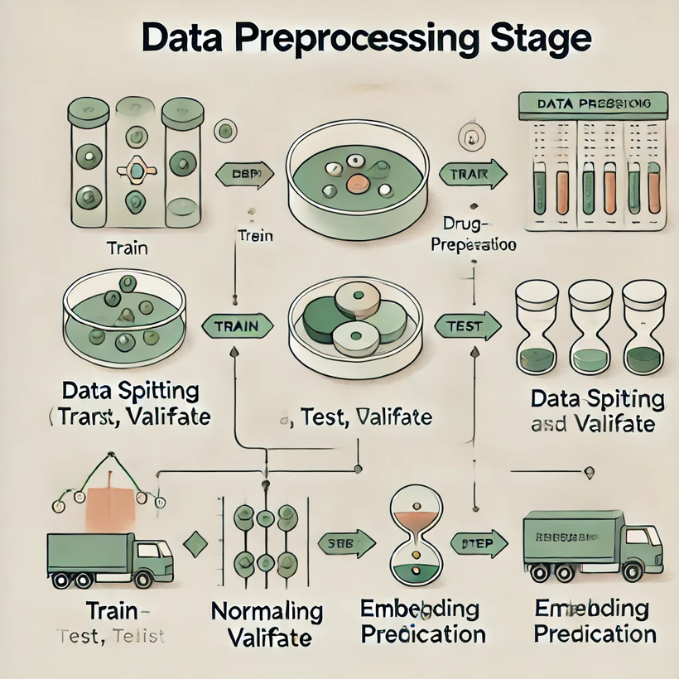
UniProt, BindingDB, ChemSpider, PubChem and PDB.
Data Preprocessing
and
Exploratory Data Analysis

Slide 13
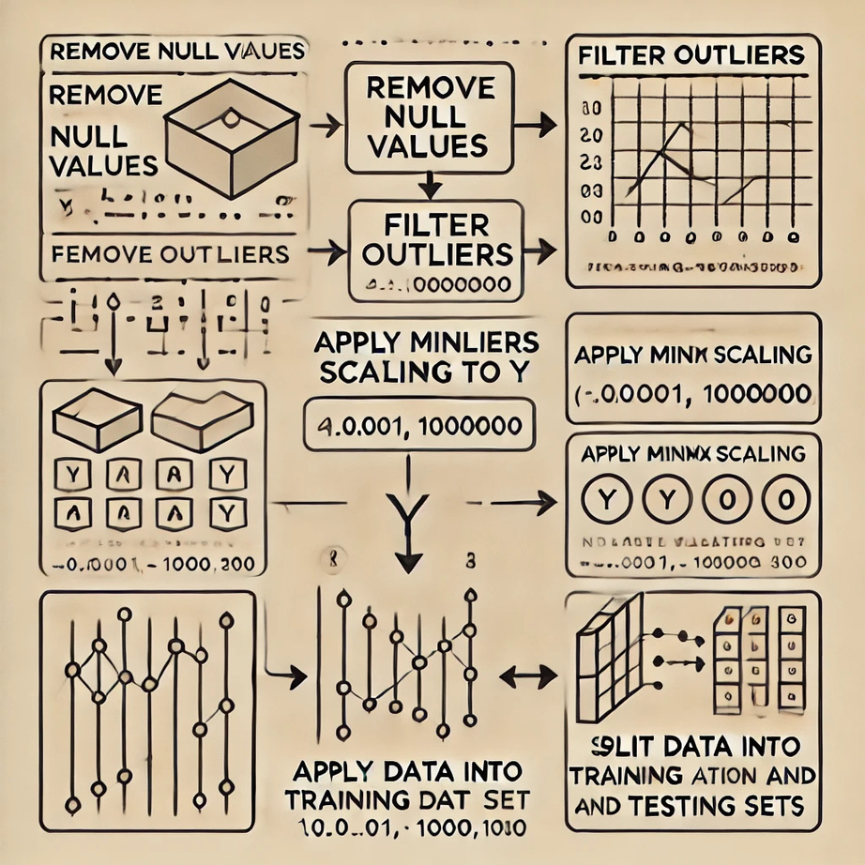
DATA CLEANING & PREPROCESSING
Null values are removed.
Outliers are filtered based on affinity values within the range [0.001, 1000000].
MinMax scaling is applied to the affinity variable (Y) to normalize values between
0 and 100
Data is split into training, validation, and testing sets (%70, %10, %20).

Slide 14
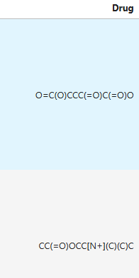
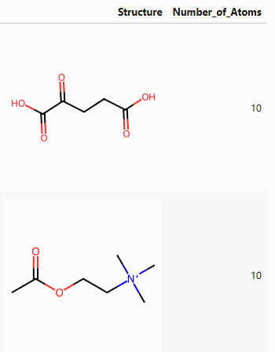
EDA

Slide 15
MODEL SELECTION
We chose a hybrid model architecture combining Transformer and Convolutional Neural Network (CNN) to capture complex representations from both drug and protein sequences, enhancing the overall quality and precision of binding affinity predictions.
Transformers for Drug Sequences
CNN for Protein Sequences

Slide 16
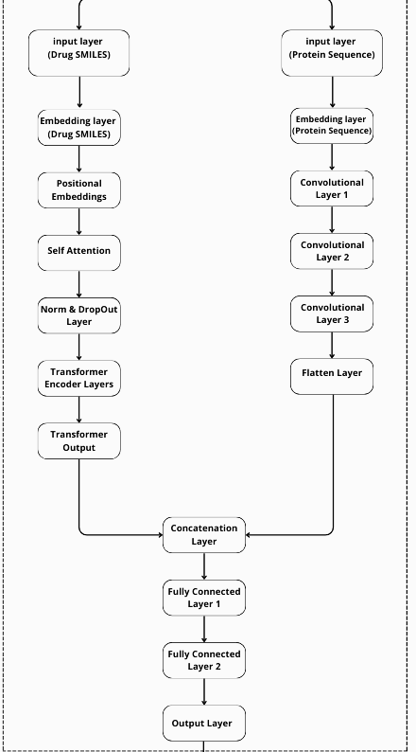
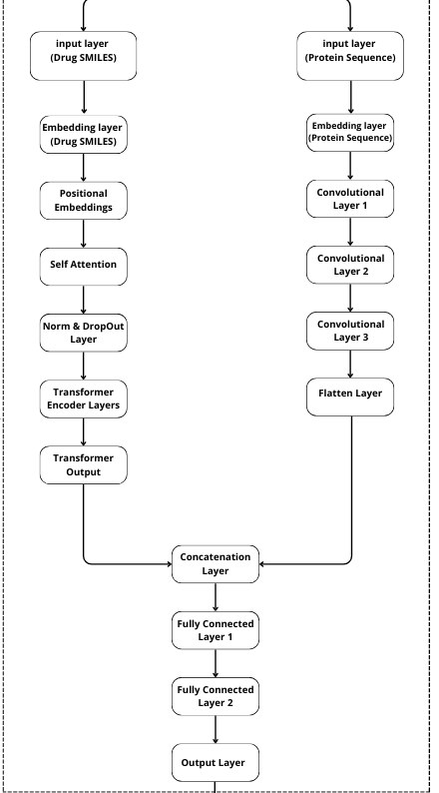
MODEL OVERVIEW
I.
II.

Slide 17
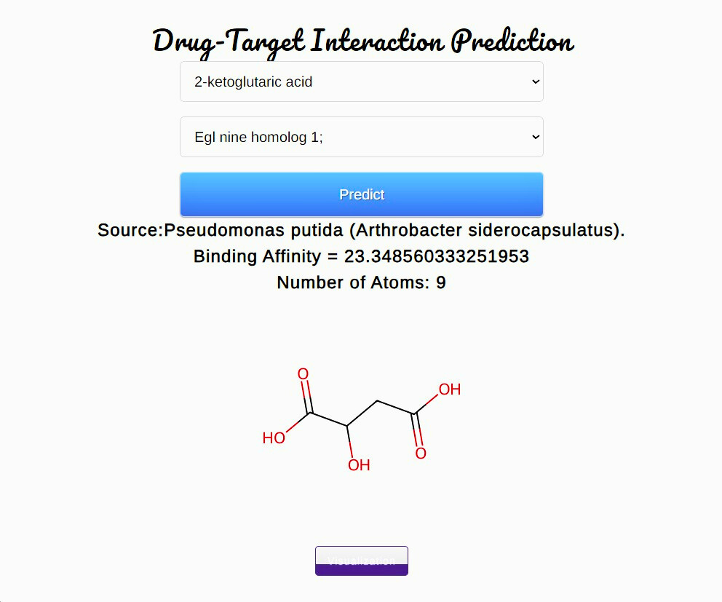
MODEL
DEPLOYMENT

Slide 18



III
Results

Slide 19

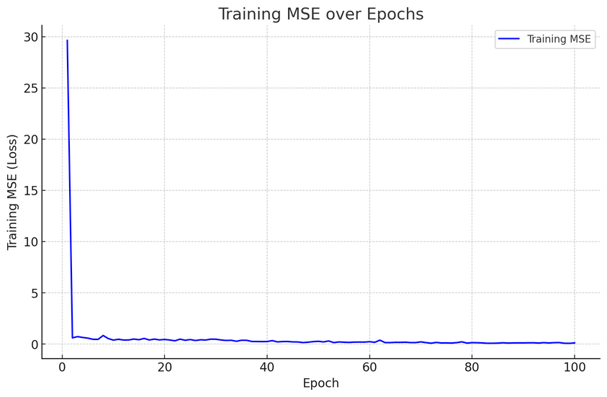
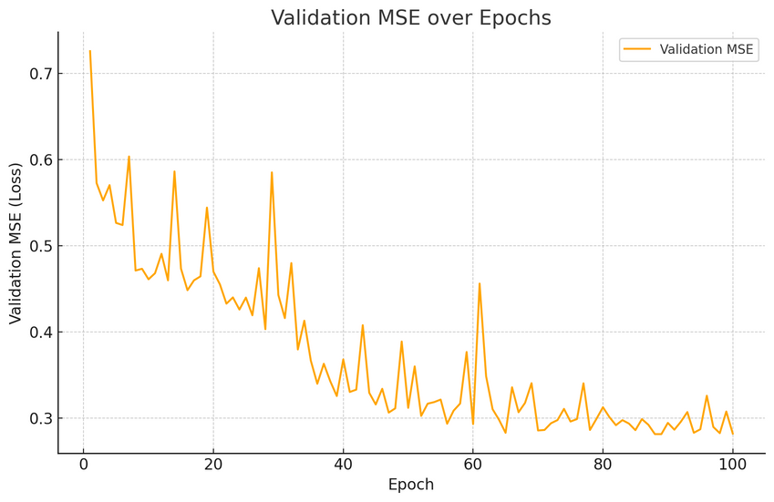
RESULTS ANALYSIS AND EVALUATION
Training and Validation Loss Over Epochs

Slide 20
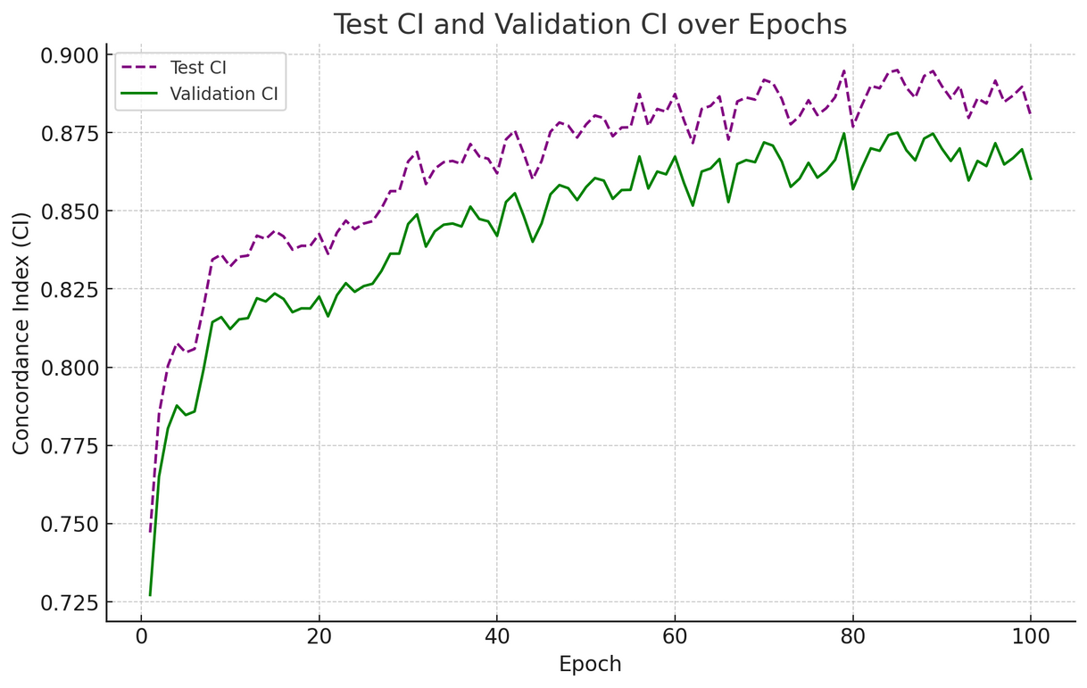
RESULTS ANALYSIS AND EVALUATION
2. Testing and Validation Concordance Index Over Epochs
FINAL EVALUATION:
MEAN SQUARE ERROR (MSE):
CONCORDANCE INDEX (CI):
0.2566
0.8682

Slide 21
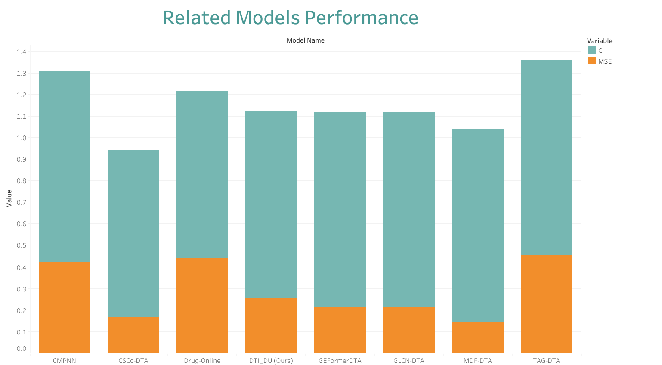
RELATED WORK

Slide 22
RELATED WORK
Year | Model Name | Methodology | Data (Interactions) | Results (MSE, CI)
2023 | CMPNN ¹ | C-MPNN combined with CPCProt & MLM for representation | Ki: 35,056 | MSE: 0.421, CI: 0.891
2024 | GEFormerDTA ² | Transformer-based graph fusion | Davis: 30,056, KIBA: 118,254 | MSE: 0.215, CI: 0.903
2024 | GLCN-DTA ³ | Extended GCN with graph learning module | Davis: 30,056, KIBA: 118,254 | MSE: 0.215, CI: 0.903
2024 | Drug-Online ⁴ | GNN and CNN-based platform for DTA, affinity, binding | (BindingDB, PDB_Binding)Ki: 58,720 rows | MSE: 0.443, CI: 0.774
2024 | TAG-DTA ⁵ | Transformer-based, binding region-guided for DTA | Davis: 947,195 rows | MSE: 0.4557, CI: 0.905
2024 | MDF-DTA ⁶ | Multi-dimensional fusion with 1D, 2D, 3D representations | Davis: 30,056, KIBA: 118,254 | MSE: 0.146, CI: 0.892
2024 | CSCo-DTA ⁷ | Cross-scale contrastive learning using GCN | Davis: 30,056, KIBA: 118,254 | MSE: 0.166, CI: 0.776
2024 | DTI_DU (Ours) | Hybrid model: Transformer + CNN for drug and protein sequences | Davis(Kd) : 42,236 rows | MSE: 0.2566, CI: 0.8682

Slide 23
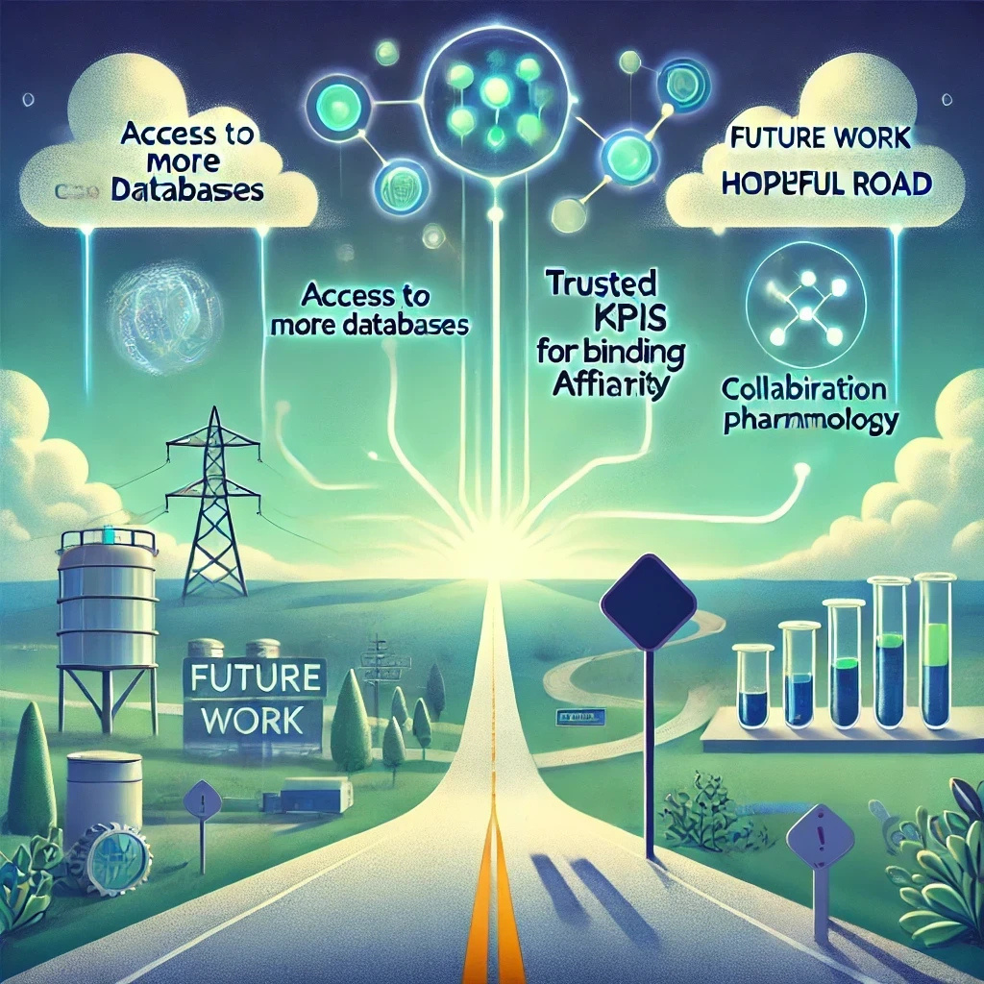

CONCLUSION AND FUTURE WORK
AI-driven drug discovery enhances efficiency and accuracy but faces challenges, including limited data access, lack of standardized KPIs for binding affinity, and the need for stronger collaboration with pharmacology experts to accelerate research.
FUTURE WORK:
Expand data access to diverse and high-quality sources.
Establish KPIs for binding affinity threshold.
Enhance collaboration with pharmacology experts to walk faster in research stages.

Slide 24



THANK YOU!
AND WE’ARE PLEASED
TO CONTACT OUR TEAM

